Slide 1


Network protocols & security
24EC2210
Topic:
Data link layer
design issues and framing
Session - 7

Slide 2



AIM OF THE SESSION
To familiarize students with the design issues of Data link layer and framing methods
INSTRUCTIONAL OBJECTIVES
This Session is designed to:
Demonstrate the design issues of data link layer.
Describe different framing methods.
LEARNING OUTCOMES
At the end of this session, you should be able to:
Define the responsibilities of datalink layer.
Apply different framing methods to form the packets into frames.
Discuss the pros and cons of framing methods.

Slide 3
Design issues of Data Link Layer
The data link layer uses the services of the physical layer to send and receive bits over communication channels.
Provides a well-defined service interface to the network layer.
The responsibilities of Datalink layer include:
Framing
Addressing
Flow Control
Error Control
Media Access Control

Slide 4
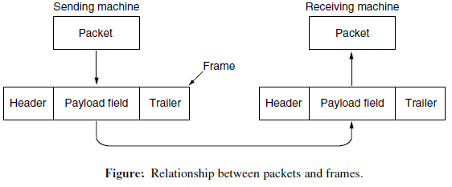
Design issues of Data Link Layer…
Framing: The data link layer divides the stream of bits received from network layer into manageable data units called Frames.
Addressing: The data link layer adds a header to the frame to define the addresses of the sender and receiver of the frame.
Flow Control: Regulating the flow of data so that slow receivers are not swamped by fast senders.
Error Control: The data link layer also adds reliability to the physical layer by adding mechanisms to detect, retransmit damaged, duplicated or lost frames.
Media Access Control: When two or more devices are connected to the same link, data link layer protocols are necessary to determine which device has control over the link at any given time.

Slide 5
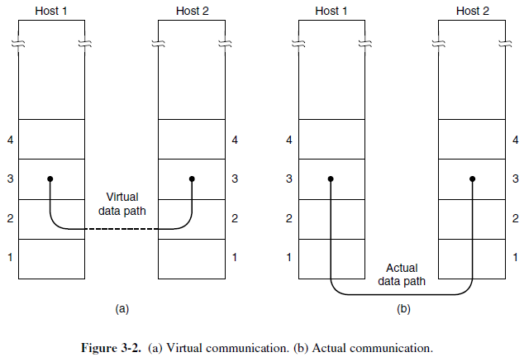
Services provided to Network Layer
The function of the data link layer is to provide services to the network layer.
The principal service is transferring data from the network layer on the source machine to the network layer on the destination machine.
1. Unacknowledged connectionless service.
2. Acknowledged connectionless service.
3. Acknowledged connection-oriented service.

Slide 6
Framing Methods

Slide 7

Framing
Breaking up the bit stream into portions is called Framing.
Each frame contains HEADER and TRAILER.
A good design must make it easy for a receiver to find the start of new frames.
Framing Methods:
1. Byte count /Character count.
2. Flag bytes with Byte stuffing.
3. Flag bits with Bit stuffing.

Slide 8
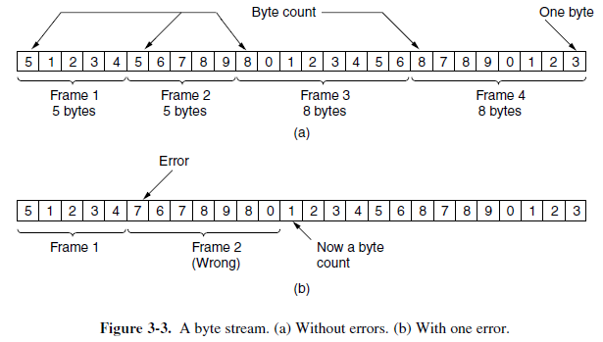
Byte count / Character count
Uses a field in the header to specify the number of bytes in the frame.
When the data link layer at the destination sees the byte count, it knows how many bytes follow and hence where the end of the frame is.

Slide 9
Example-1
Given Message P = 1 2 3 4 5 6 7 8 9
Payload size of frames: F1 =3, F2 = 2, F3 = 4
Perform byte count method and write the final byte sequence.
F1 = ?
F2 = ?
F3 = ?
Final Byte Sequence = ?

Slide 10
Solution-1
Given Message P = 1 2 3 4 5 6 7 8 9
Payload size of frames: F1 =3, F2 = 2, F3 = 4
Sol:
F1 =
F2 =
F3 =
Final Byte Sequence =
4 | 1 | 2 | 3
3 | 4 | 5
5 | 6 | 7 | 8 | 9
4 | 1 | 2 | 3 | 3 | 4 | 5 | 5 | 6 | 7 | 8 | 9

Slide 11
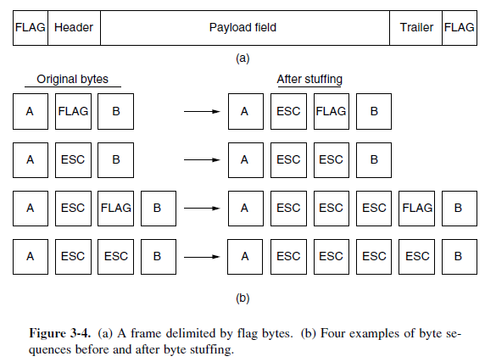
Byte Stuffing / Character Stuffing
Same byte, called a flag byte, is used as both the starting and ending delimiter.
Two consecutive flag bytes indicate the end of one frame and the start of the next.
Thus, if the receiver ever loses synchronization it can just search for two flag bytes to find the end of the current frame and the start of the next frame.

Slide 12
Example-2
Given FLAG = @, ESC = $, Frame format= FLAG DATA FLAG
Original Data | Stuffed Data | Destuffed Data
D1 = ABC | F1 = @ABC@ | R1 = ABC
D2 = P@QR | F2 = ? | R2 = ?
D3 = P@QR$ | F3 = ? | R3 = ?

Slide 13
Solution-2
Given FLAG = @, ESC = $, Frame format= FLAG DATA FLAG
Original Data | Stuffed Data | Destuffed Data
D1 = ABC | F1 = @ABC@ | R1 = ABC
D2 = P@QR | F2 = @P$@QR@ | R2 = P@QR
D3 = P@QR$ | F3 = @P$@QR$$@ | R3 = P@QR$

Slide 14
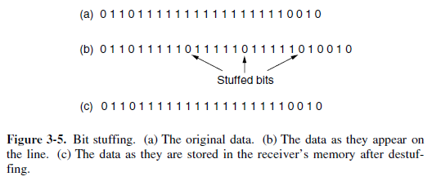
Bit Stuffing
Framing can be also be done at the bit level, so frames can contain an arbitrary number of bits made up of units of any size.
Flag byte: 01111110 or 0x7E in hexadecimal
Whenever the sender’s data link layer encounters five consecutive 1s in the data, it automatically stuffs a 0 bit into the outgoing bit stream.

Slide 15
Example-3
FLAG = 01111110
M1 = 1010100001110010111101
F1= ?
Flag = 01111110
M2 = 1010111111011011111100000110
F2 = ?
FLAG = 011110
M3 = 11001011110101110
F3 = ?

Slide 16
Solution-3
FLAG = 01111110
M1 = 1010100001110010111101
F1= 01111110 1010100001110010111101 01111110
Flag = 01111110
M2 = 1010111111011011111100000110
F2 = 01111110 101011111010110111110100000110 01111110
FLAG = 011110
M3 = 11001011110101110
F3 = 011110 1100101110101011100 011110

Slide 17
Example-4
The following character encoding is used in a data link protocol:
A: 01000111; B: 11100011; FLAG: 01111110; ESC: 11100000; Show the bit sequence transmitted (in binary) for the four-character frame
“A FLAG B ESC”
when each of the following framing methods is used:
Byte count.
Flag bytes with byte stuffing.
Starting and ending flag bytes with bit stuffing.

Slide 18
Solution-4
Given Data: A= 01000111; B= 11100011; FLAG= 01111110; ESC= 11100000;
Byte Seq: A FLAG B ESC
Byte count:
Byte stuffing:
Bit stuffing: F A F B E F
Byte Seq: | 5 | A | FLAG | B | ESC
Bit Seq: | 00000101 | 01000111 | 01111110 | 11100011 | 11100000
Byte Seq: | FLAG | A | ESC | FLAG | B | ESC | ESC | FLAG
Bit Seq: | 01111110 | 01000111 | 11100000 | 01111110 | 11100011 | 11100000 | 11100000 | 01111110
Bit Seq. before Stuffing: |  | 01000111 01111110 11100011 11100000
Bit Seq after Stuffing: | 01111110 | 01000111 011111010 11100011 111000000 | 01111110

Slide 19
SELF-ASSESSMENT QUESTIONS
Which among the following represents the objectives/requirements of Data Link Layer??
Frame Synchronization
Error & Flow Control
Both a & b
Neither a or b
The data link layer takes the packets from _____ and encapsulates them into frames for transmission.
application layer
transport layer
network layer
physical layer
3. In bit stuffing framing method if the flag is 0111110, then after how many 1’s the 0 must be stuffed in data?
After every six 1’s
After every five 1’s
After every four 1’s
After every three 1’s

Slide 20
SELF-ASSESSMENT QUESTIONS
Which among the following represents the objectives/requirements of Data Link Layer??
Frame Synchronization
Error & Flow Control
Both a & b
Neither a or b
The data link layer takes the packets from _____ and encapsulates them into frames for transmission.
application layer
transport layer
network layer
physical layer
3. In bit stuffing framing method if the flag is 0111110, then after how many 1’s the 0 must be stuffed in data?
After every six 1’s
After every five 1’s
After every four 1’s
After every three 1’s

Slide 21

Responsibilities of Datalink layer
Framing
Framing Methods
Byte Count
Byte Stuffing
Bit Stuffing

Slide 22
TERMINAL QUESTIONS
1. Describe the design issues of data link layer.
2. Illustrate different framing methods with examples.
3. Analyze the pros and cons of each of the framing methods.

Slide 23
REFERENCES FOR FURTHER LEARNING OF THE SESSION
Reference Books:
A.S. Tanenbaum, David J. Wetheral “Computer Networks” Pearson, 5th Edition.
Kurose, J and Ross, K Computer Networking: A Top-Down Approach Addison-Wesley- 6th edition.
Sites and Web links:
https://www.geeksforgeeks.org/various-kind-of-framing-in-data-link-layer/

Slide 24


Slide 25
THANK YOU
Team – Network Protocols & Security

